Slide 1
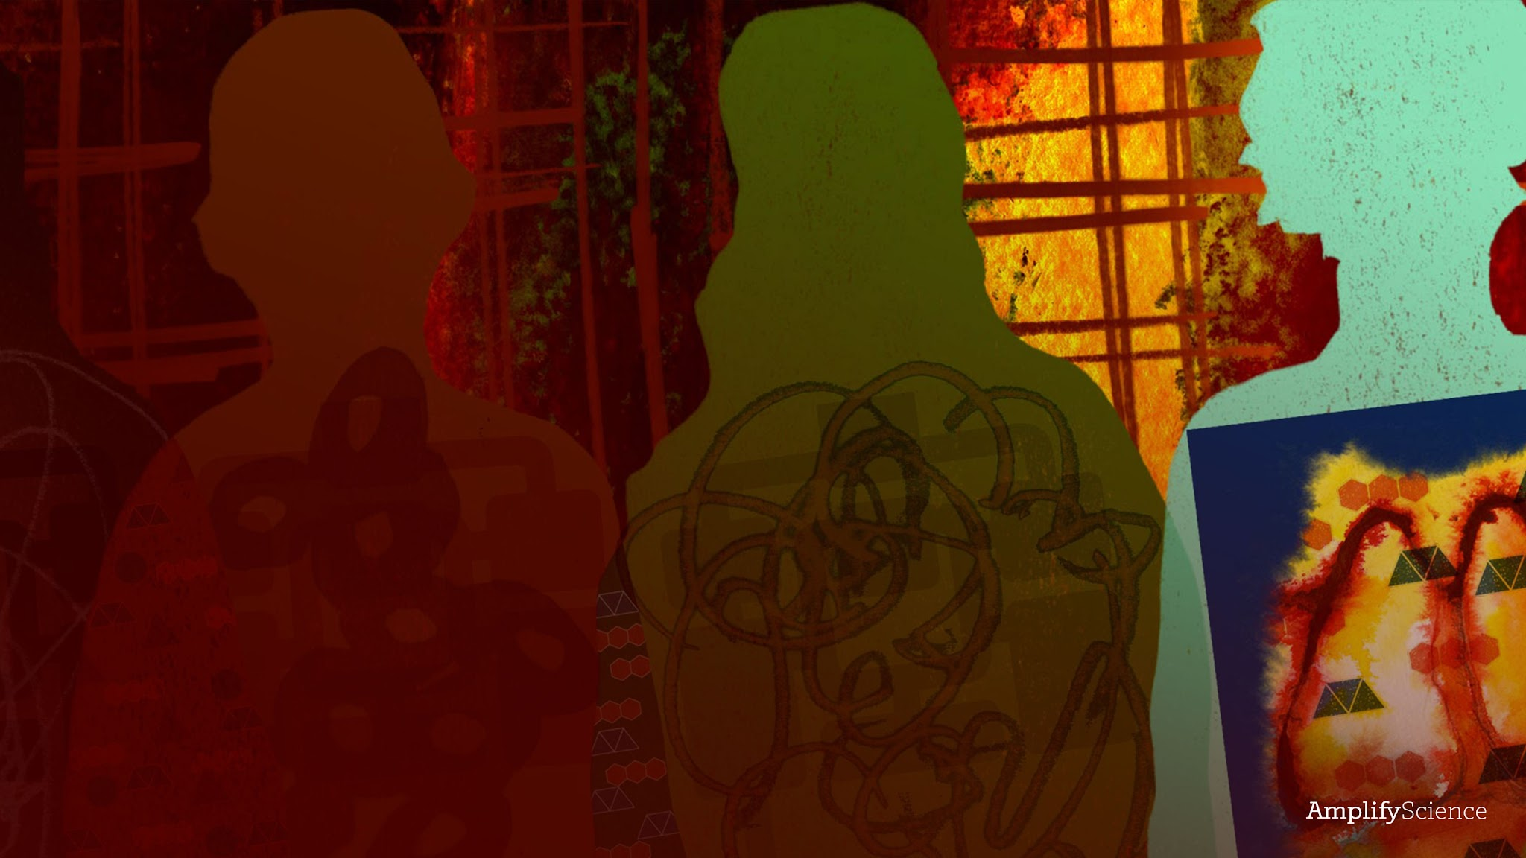
Metabolism
Lesson 2.3: Learning More About a Condition

Slide 2
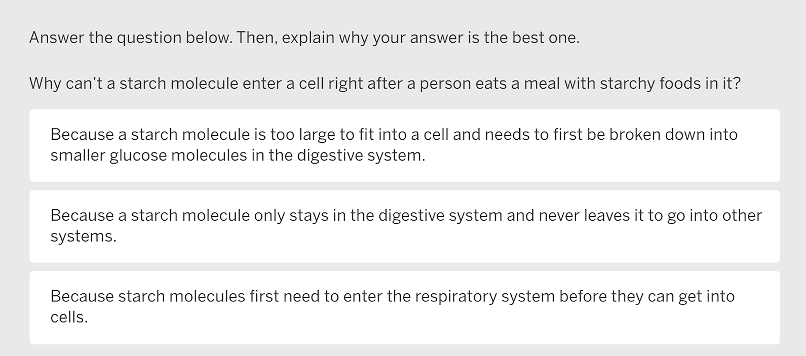
Warm-Up

Slide 3

Second Read of Patient
Stories Articles
The hospital medical team thinks that Elisa might have asthma, anemia, diabetes, or a pancreas injury. Each of you is becoming an expert on one of these conditions.
Part of understanding the conditions deeply will come from the careful reading that you did in the previous lesson.
First, you will reread your article about your condition, focusing on the information you will need to help you make an accurate model.
As you read, you should highlight any information that helps you answer the questions and prepare to make your models.

Slide 4
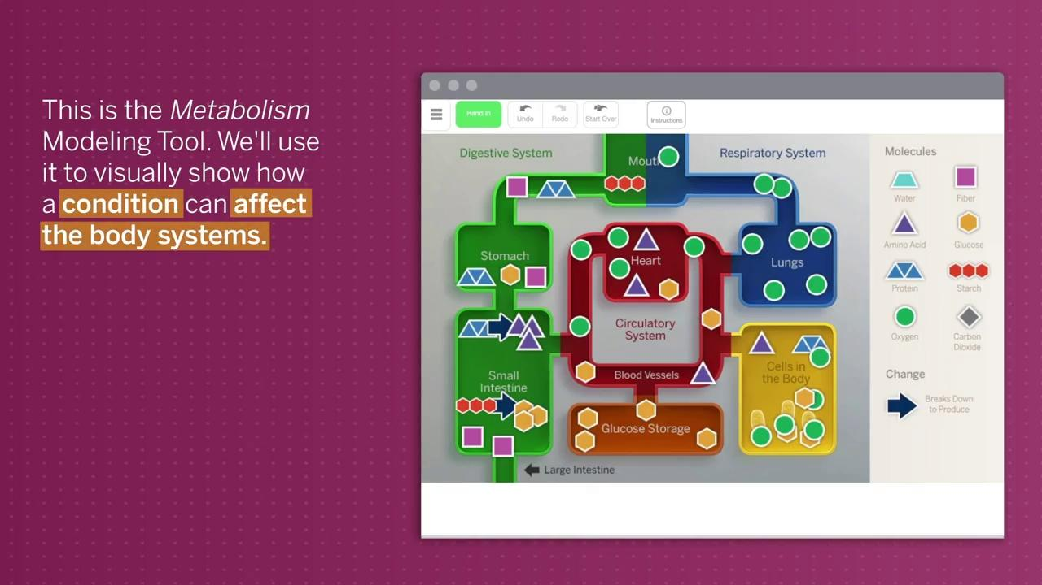

Slide 5
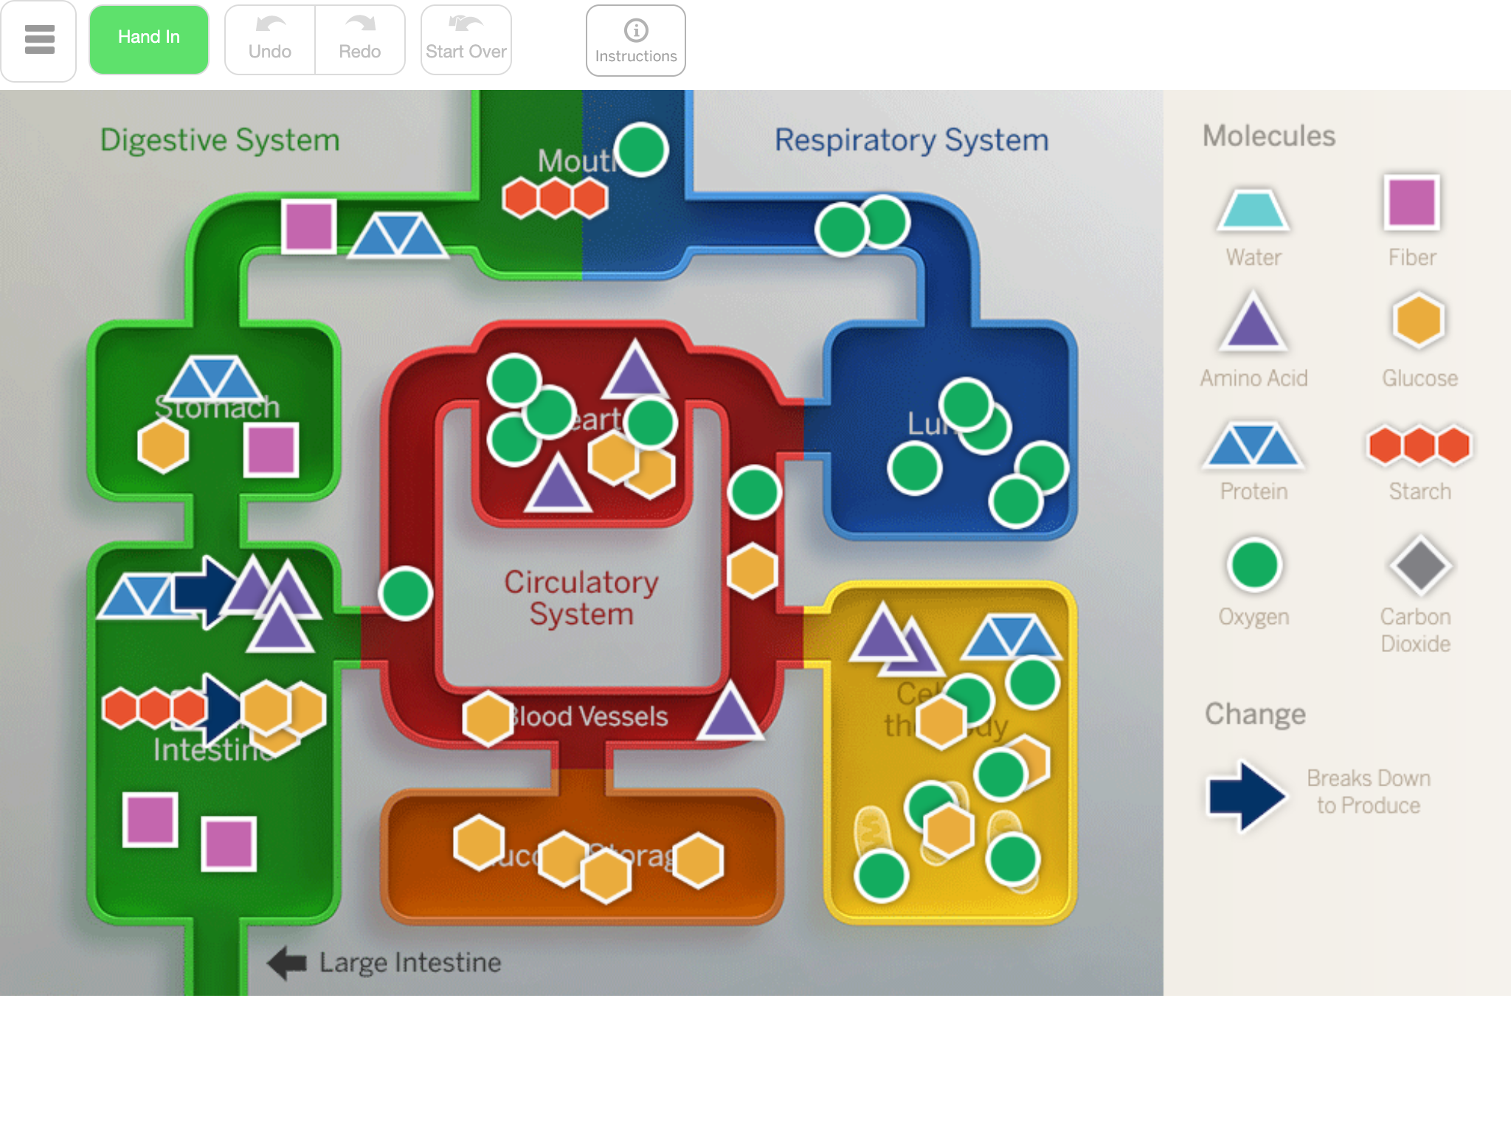
Modeling Tool
Today, we’ll use the Modeling Tool to make a model of what is happening in the body of a patient with whichever condition you read about.
First, you will reread your article about your condition, focusing on the information you will need to help you make an accurate model.
As you read, you should highlight any information that helps you answer the questions and prepare to make your models.

Slide 6
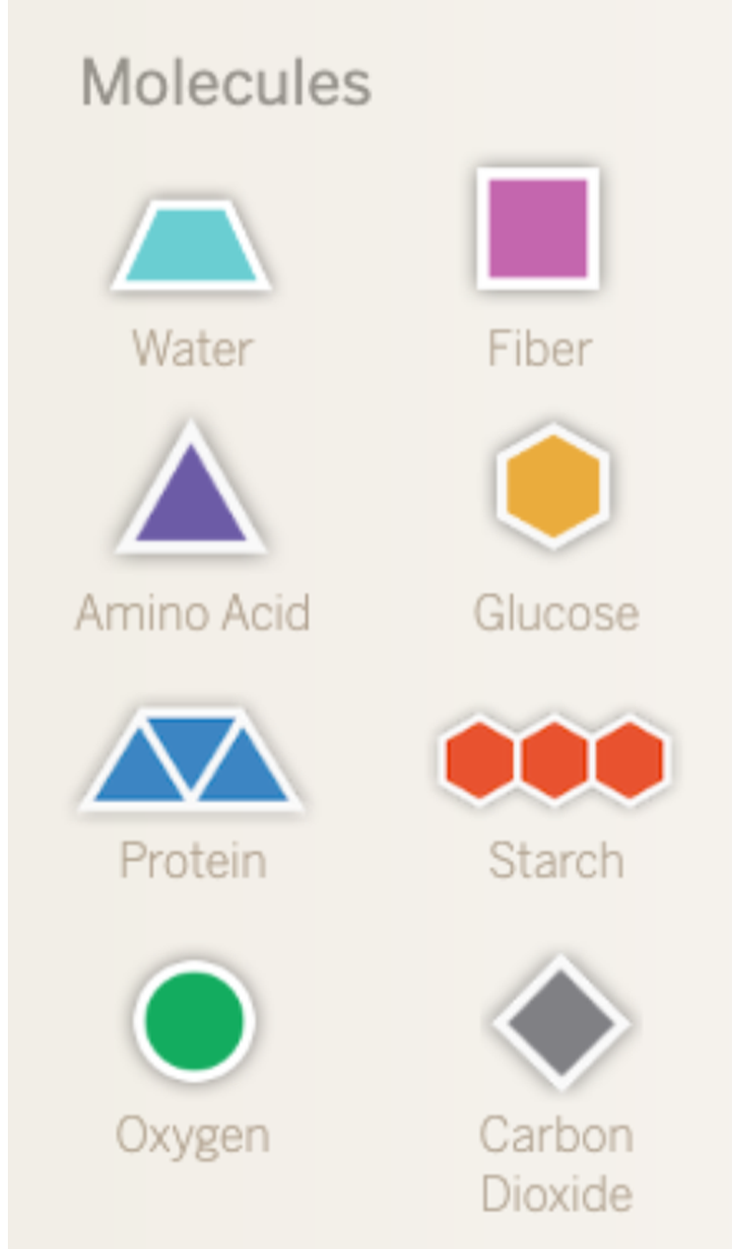
Modeling a Condition
To help diagnose Elisa, you’ll use what you learned from the article to make a model in the Modeling Tool that shows visually how that condition affects the body systems.
Let’s talk through the molecules that are found in the different body systems of a healthy body.

Slide 7
Modeling a Condition
You will change this Healthy Body Model to represent what would be different in the body of a person with the condition that you read about.
We’ll look at an example that is not one of the conditions you read about.
Let’s look at how to make a model of someone who is choking.
Your models will be more complex than the choking model. You should go back and forth between the article, the questions you answered in the previous activity, and the model.

Slide 8
Comparing Models to the Sim
Next, you will observe your conditions in the Sim. You’ll take screenshots of what you observe and add annotations, comparing the Sim to the models you made.
Launch the Metabolism Sim.
Select the condition you read about (asthma, anemia, diabetes, or pancreas injury), and then select OBSERVE.
Feed and observe the body.
Take a screenshot and upload it below.
Add annotations to the screenshot, explaining what you observed in the Sim and how it fits with your model or doesn’t fit with your model.

Slide 9
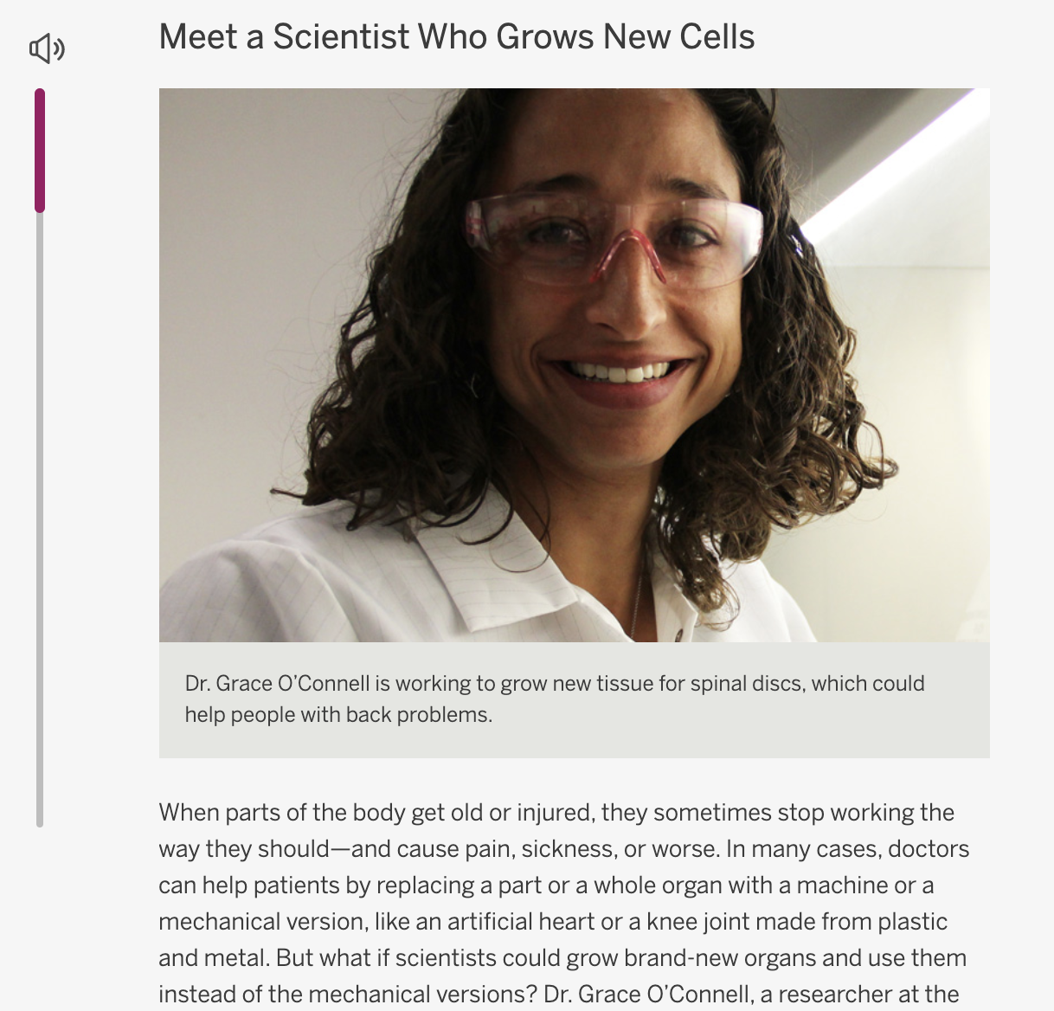
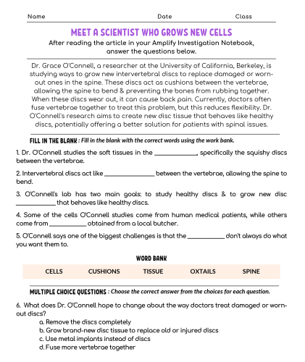
Homework
For this activity, you will:
Record your current ideas about Elisa’s diagnosis
Read and answer te article questions about growing cells

